Slide 1
Tips from the SharePoint Framework Development Trenches
SPS

Slide 2
Beau Cameron
Professional
Professional areas of focus
Personal
How I plan my time outside of work
Site Provisioning
Binge-watching TV
90%
40%
SharePoint Framework
Hiking & Camping
75%
90%
Azure
Travel
50%
50%
Community
Making PowerPoints
100%
5%
@Beau__Cameron
beau@beaucameron.net

Slide 3
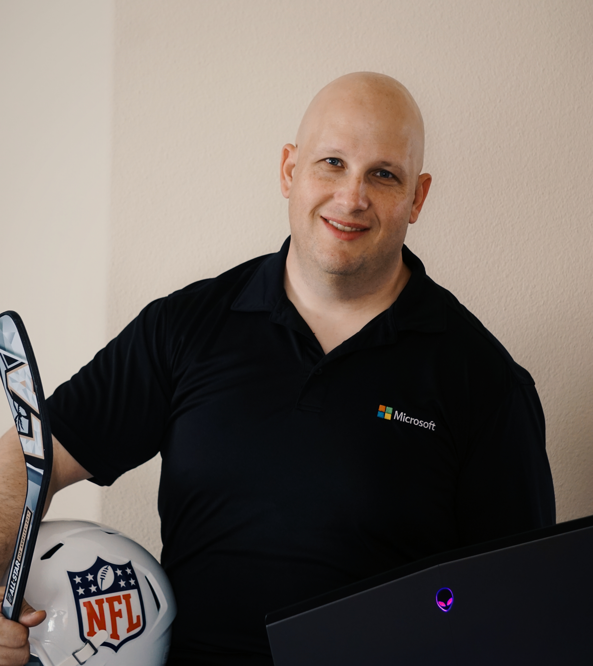
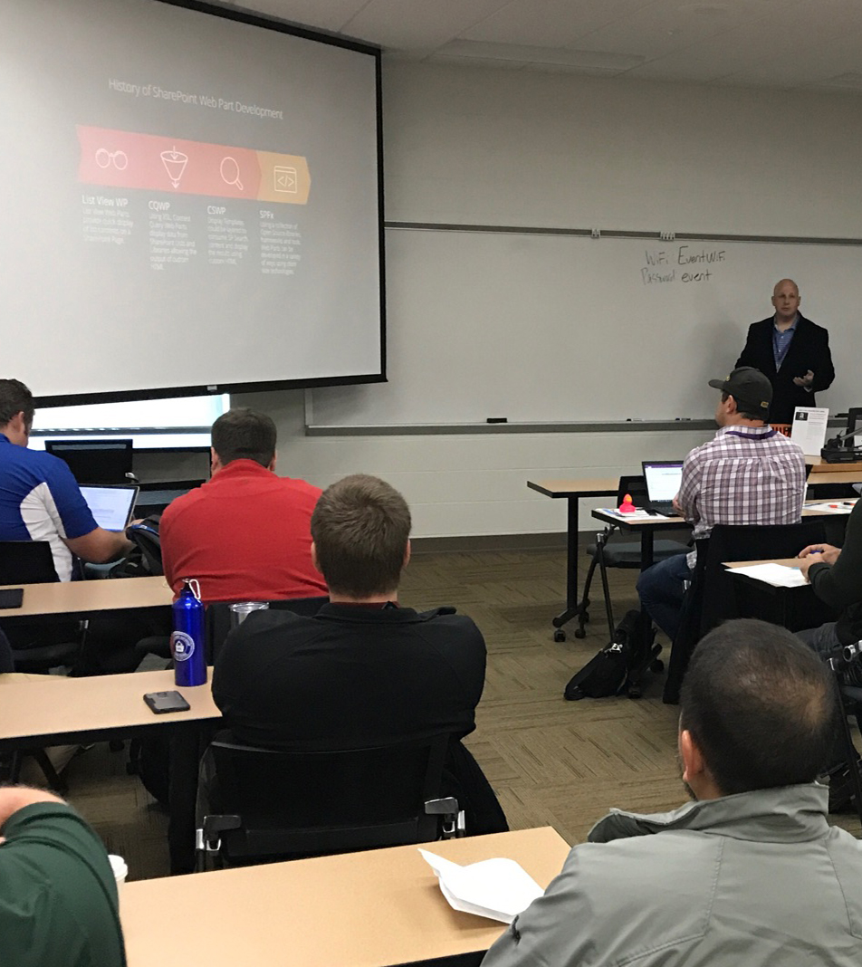
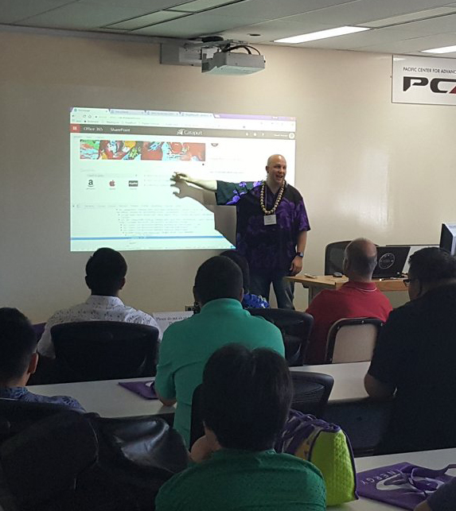
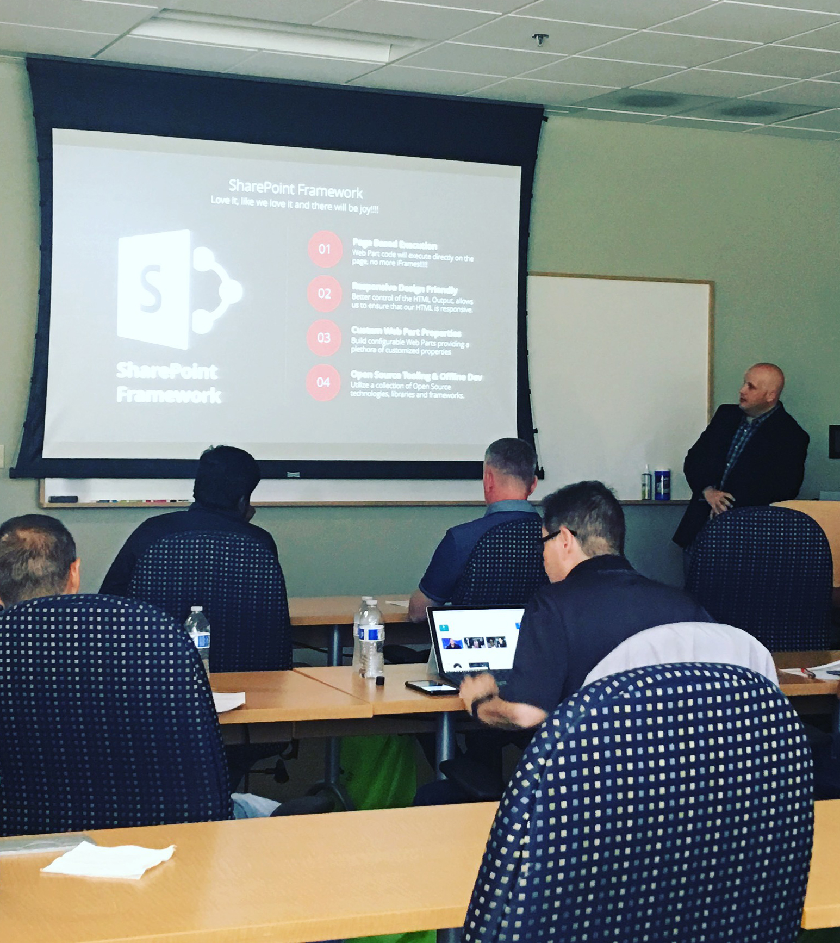
David
Warner II
@davidwarnerii
david@warner.digital
www.catapultsystems.com
http://warner.digital

Slide 4
Agenda
Community Engagement
SPFx Tooling
Development Overview & Tips
Power User Tips
SPFx Deployment Options
SPFx Debugging & Management

Slide 5
Patterns & Practices
Community Calls
http://aka.ms/sppnp
GitHub Repositories
https://github.com/pnp
https://github.com/sharepoint
Issue Support
http://aka.ms/spdev-issues

Slide 6
SPFx Tooling

Slide 7
SharePoint Framework Tool Chain
What do you focus on?
TypeScript
Yeoman
Gulp
Node
Frameworks: Angular, Knockout, React, Etc.
VS Code

Slide 8
Docker for SPFx Development
No local dependencies
Switch between SPFx version instantly
Test new versions of any modules with ease

Slide 9
Docker SPFx Development
Host OS
Windows 10 Pro
Docker
Low Memory Requirements
Fast Startup Time
Easily switch between
SPFx, Node, Yo, Gulp Versions
SPFx
v1.5.1
Node vX.X
Yo vX.X
SPFx
v1.6.0
Node vX.X
Yo vX.X

Slide 10
DEMO Using Docker

Slide 11
pnpm
Hard links packages from node_modules folder to the package cache
Much smaller project folders
Faster creation of new projects

Slide 12
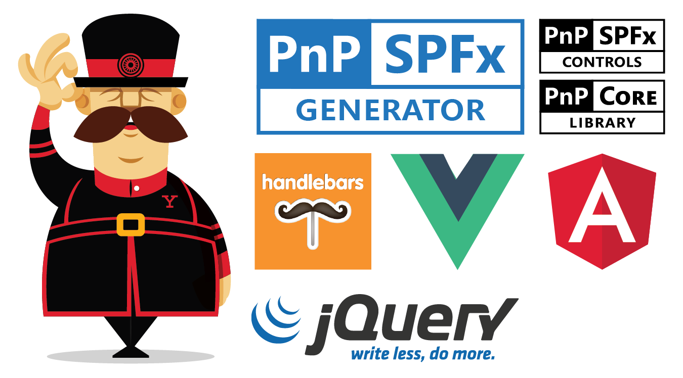
PnP Yeoman Generator
Scaffolds third-party libraries such as Vue, jQuery and Angular
Supported by Microsoft
Open Source

Slide 13
SPFx Development Overview

Slide 14
SPFx Solution Options
Feature Framework
Lists, Libraries, Content Types, Site Columns
Extensions
Application Customizers
Command Sets
Field Customizer
Web Parts

Slide 15
SharePoint Development Tips

Slide 16
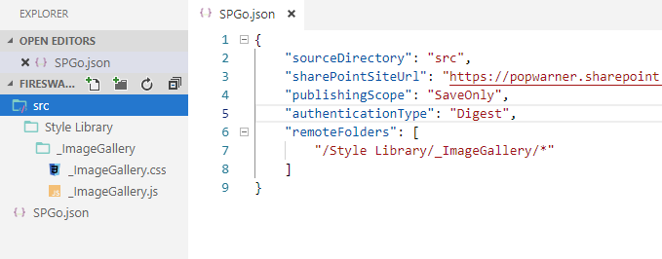
SharePoint Classic VSCode Support
Connect directly to SP with full edit and save support
Use VSCode for editing of .js/.css/etc
VSCode Extension:
SPGo
https://marketplace.visualstudio.com/items?itemName=SiteGo.spgo

Slide 17
DEMO SPGo VS Code Extension

Slide 18
Minimal Path to Awesome
npm I
gulp clean
gulp bundle --ship
gulp package-solution --ship

Slide 19
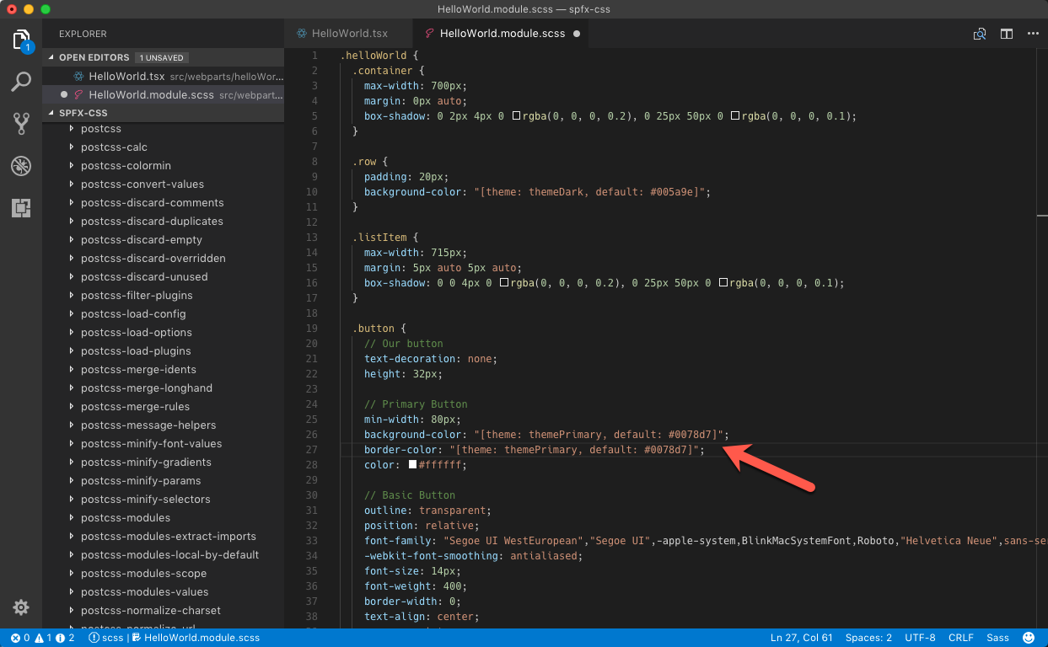
Theme Colors in SPFx Solutions
Inherit theme colors in web parts and extensions to provide consistent styling.
Notes:
https://docs.microsoft.com/en-us/sharepoint/dev/spfx/use-theme-colors-in-your-customizations

Slide 20
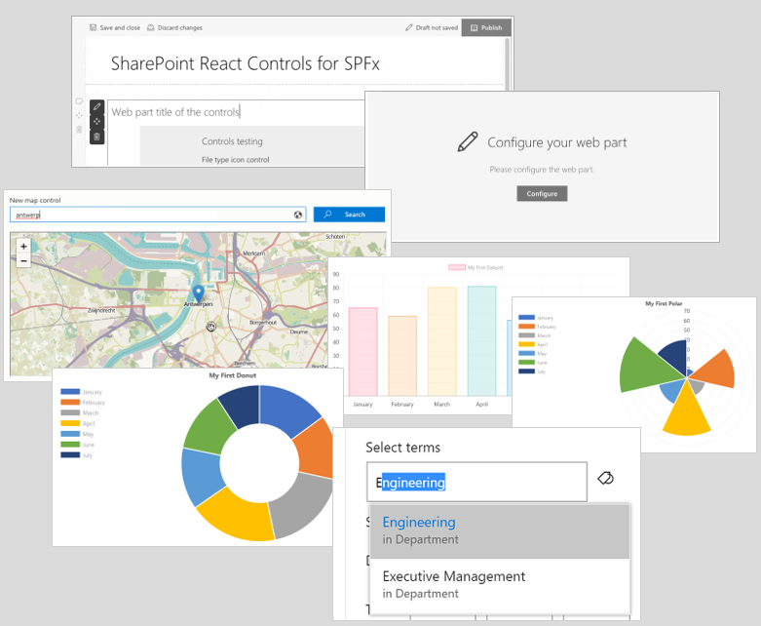
PnP Reusable Controls
Property Pane Controls
This repository provides developers with a set of reusable property pane controls that can be used in their SharePoint Framework (SPFx) solutions.
React Components
This repository provides developers with a set of reusable React controls that can be used in SharePoint Framework (SPFx) solutions. The project provides controls for building web parts and extensions.

Slide 21
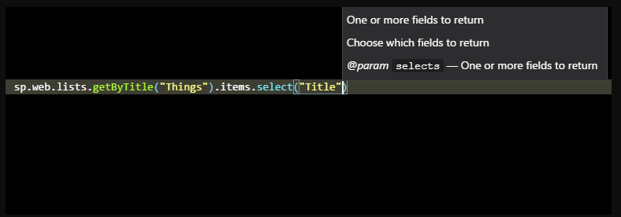
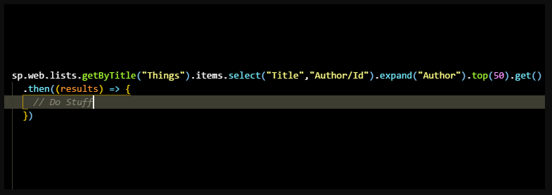
PnPjs
Intellisense & Type checking
Simplify development experience
Intuitive using fluent library
Easier to read code intent
Asynchronous, built on Promises
Built-in caching
https://pnp.github.io/pnpjs/

Slide 22
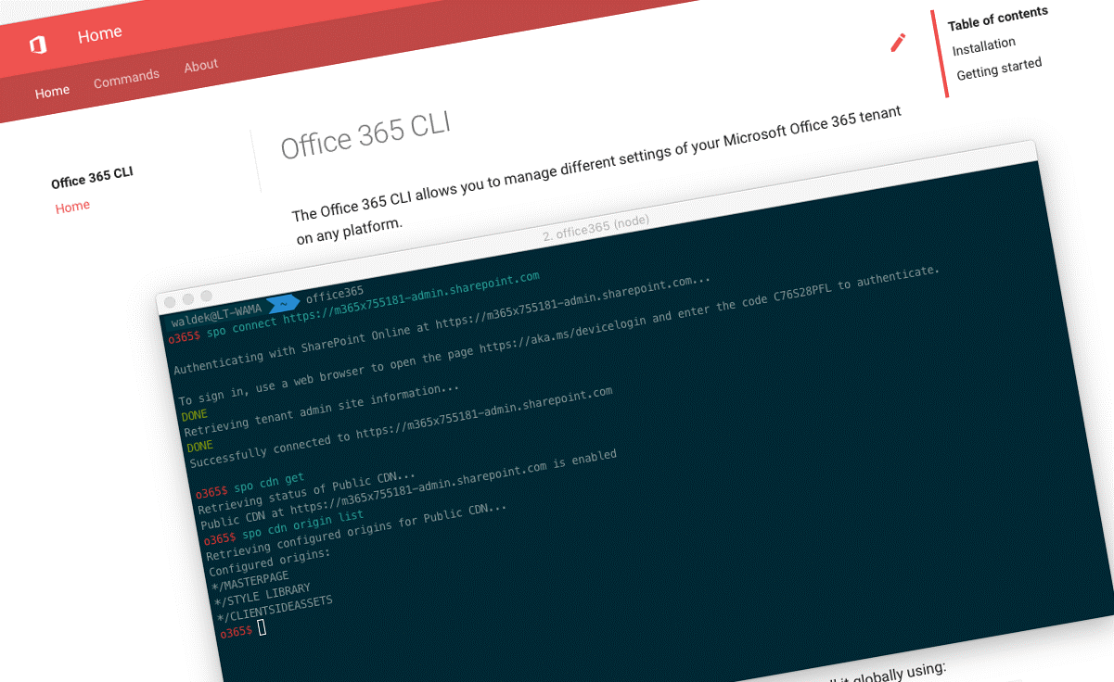
Office365 CLI (Command Line Interface)
Management of Office365 Tenant
OS Independent
Windows
macOS
Linux
SPFx Upgrades
Compatible with Docker
https://pnp.github.io/office365-cli

Slide 23
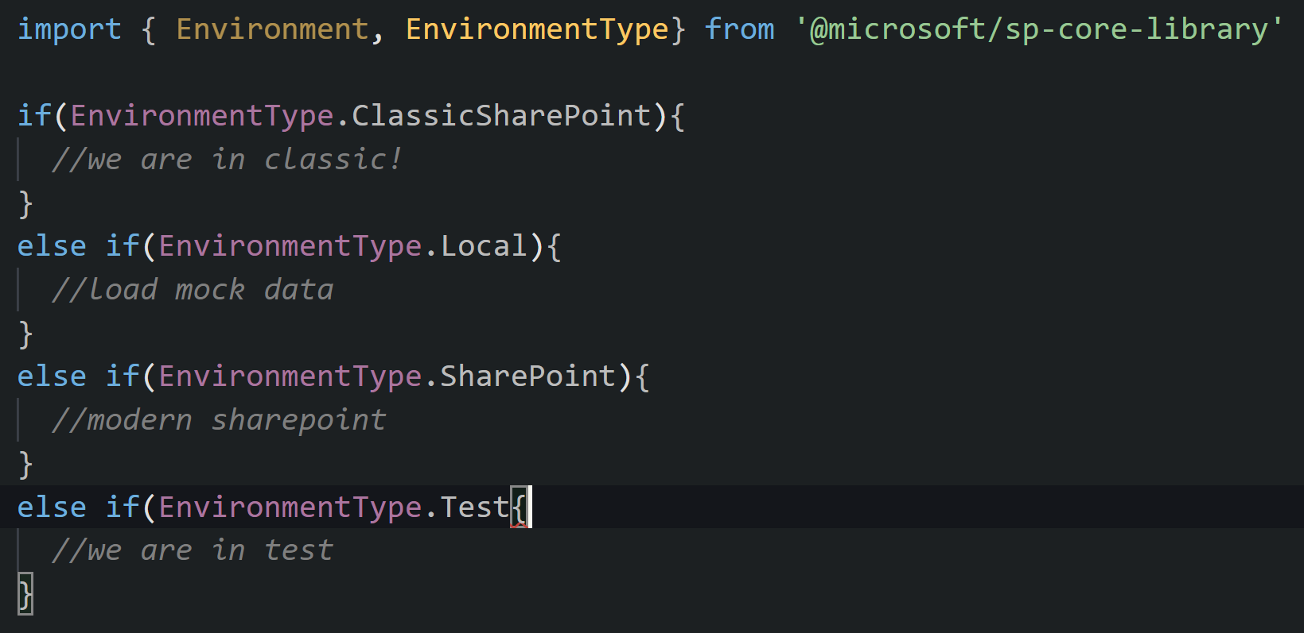
Environment Variables
Use Environment variables to determine which environment your SPFx solution is running

Slide 24
Maintenance Mode
?maintenanceMode=true
where the web part bundle is hosted
which external scripts is the web part loading and from where
what version of the SharePoint Framework has the web part been built on
which components of the SharePoint Framework does the web part use

Slide 25
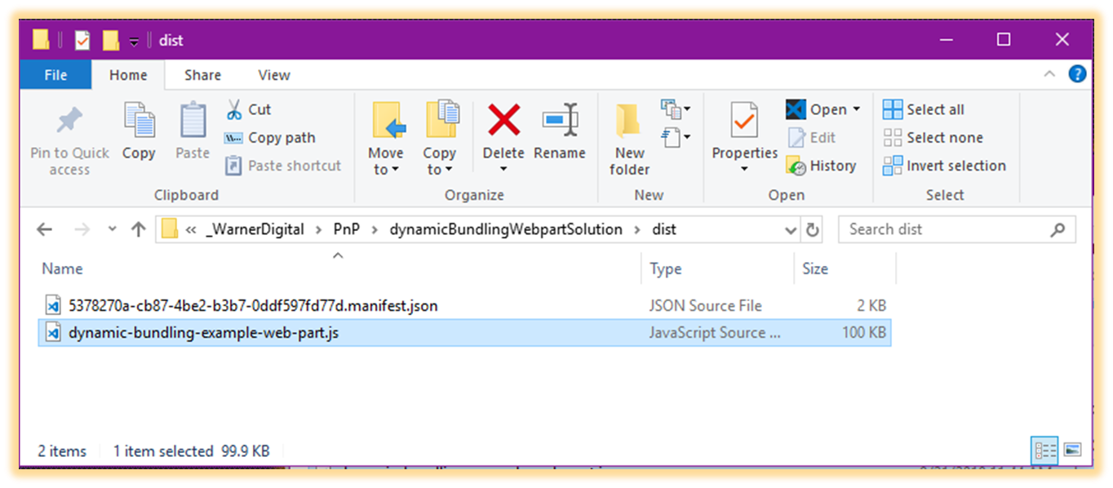
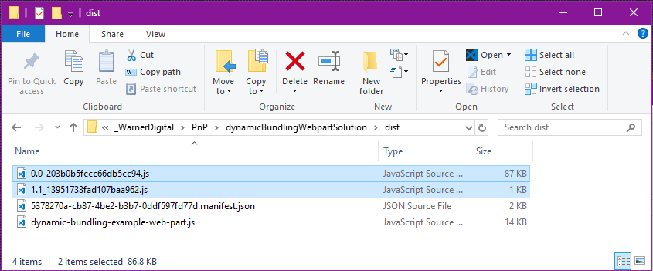
SPFx Dynamic Bundling
Split functionality into multiple .js files
Load additional .js files at execution time
Reduces initial load of solution
https://github.com/SharePoint/sp-dev-fx-webparts/tree/master/samples/js-dynamic-bundling-libraries

Slide 26
DEMO Dynamic Bundling

Slide 27
SharePoint Power User Tips

Slide 28
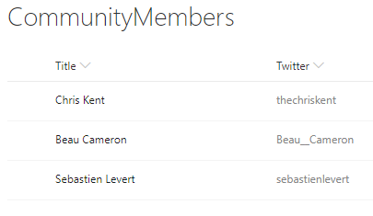
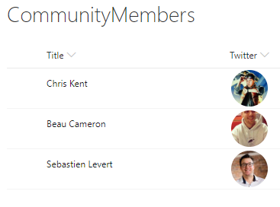
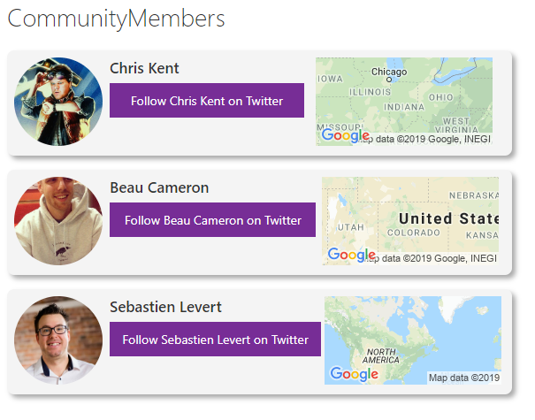
List Formatting
Column Formatting:
Control the Styling and Content of List Columns
View Formatting
Override the entire row
Deployment Strategy Sample:
http://bit.ly/LFDeploy
GitHub Sample Repository:
https://github.com/SharePoint/sp-dev-list-formatting

Slide 29
SPFx Deployment Options

Slide 30
App Catalog Options
Tenant App Catalog
Managed by Tenant Administrators
Tenant Scoped Deployment
Site Collection App Catalog
Managed by Site Collection Administrators
Site Collection scoped deployment
Perfect for development Site Collections in single Tenant

Slide 31
SPFx Provisioning Options – ALM APIs
Add to App Catalog
/_api/web/tenantappcatalog/Add(overwrite=true, url='test.txt')
Deploy From App Catalog
/_api/web/tenantappcatalog/AvailableApps/GetById('xxxxxxxx-xxxx-xxxx-xxxx-xxxxxxxxxx')/Deploy
Retract solution packages from sites
/_api/web/tenantappcatalog/AvailableApps/GetById('xxxxxxxx-xxxx-xxxx-xxxx-xxxxxxxxxx')/Retract
Remove solution packages
/_api/web/tenantappcatalog/AvailableApps/GetById('xxxxxxxx-xxxx-xxxx-xxxx-xxxxxxxxxx')/Remove
List available packages in app catalog
/_api/web/tenantappcatalog/AvailableApps
Get details of solution package
/_api/web/tenantappcatalog/AvailableApps/GetById('xxxxxxxx-xxxx-xxxx-xxxx-xxxxxxxxxx')
Install Solution Package from App Catalog
/_api/web/tenantappcatalog/AvailableApps/GetById('xxxxxxxx-xxxx-xxxx-xxxx-xxxxxxxxxx')/Install
Uninstall Solution Package from site
/_api/web/tenantappcatalog/AvailableApps/GetById('xxxxxxxx-xxxx-xxxx-xxxx-xxxxxxxxxx')/Uninstall
Test
Maintain
Build
Automate SPFx

Slide 32
SPFx Provisioning Options – Site Designs
Extensions
{
"verb": "associateExtension",
"title": "SPFXApplicationCustomizer Example",
"location": "ClientSideExtension.ApplicationCustomizer",
"clientSideComponentId": "40d64749-a6e5-4691-b440-1e32fb6sean5",
"scope": "Web"
}
Add-ins & SPFx Web Parts
{
"verb": "installSolution",
"id": "d40e4edc-a6da-4cd8-b82d-bba970976803"
}

Slide 33
SPFx Provisioning Options – PnP/CSOM
PowerShell
Add-PnPClientSideWebPart -Page MyPage -Component "HelloWorld"
Add-PnPClientSideWebPart -Page MyPage -DefaultWebPartType BingMap
C#
ClientSidePage csp = ClientSidePage.Load(ctx, "MyPage");
ClientSideText text = new ClientSideText() { Text = "PnP Is Awesome"}
csp.AddControl(text, -1);

Slide 34
SPFx Provisioning Options – PnP/CSOM
Provisioning Templates
Augment Site Design provisioning (Azure Functions / Azure Automation)
Use PowerShell

Slide 35
SPFx Debugging & Management

Slide 36
SPFx Production Debugging
Problem:
Issue or Error is only visible in a specific tenant or site collection
Solution:
Serve deployed SPFx solution from localhost
URL Querystring:
?loadSPFX=true&debugManifestsFile=https://localhost:4321/temp/manifests.js

Slide 37
Finding SPFx Web Parts in Tenant
Problem
Finding where SPFx Web Parts are being used in a Tenant
Possible Solution (Modern Only)
SharePoint Search
SPFx Web Parts stored in CanvasContent1
https://testsite.sharepoint.com/sites/test/_api/search/query?QueryText='RefinableString100:62799350-83b2-40a1-b35d-5417cc54daea*'&selectProperties='Title,Path,SPWebUrl’
Blog Post

Slide 38
Application Insights
Pros
Track request rates, response times, failures
Track exceptions and errors
Track page views and page load performance
Monitor Ajax calls
Custom events and metrics
Cons
Only tracks when a web part is loaded
Pages that haven’t been visited in a while may not show up in your report

Slide 39
Thank You for attending!!
Beau Cameron
Twitter : @beau__cameron
Email : beau@beaucameron.net
Blog : www.beaucameron.net
David Warner
Twitter : @DavidWarnerII
Email : david@dwarnerii.com
Blog : http://warner.digital

